Slide 1

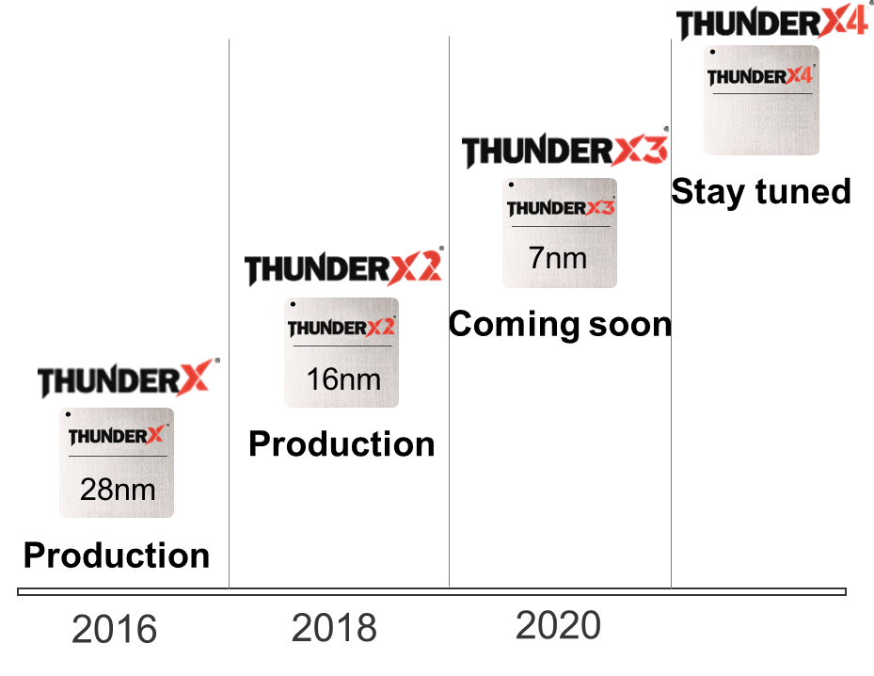
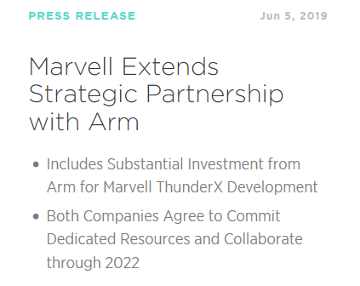



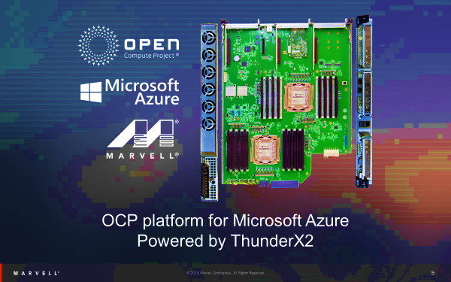
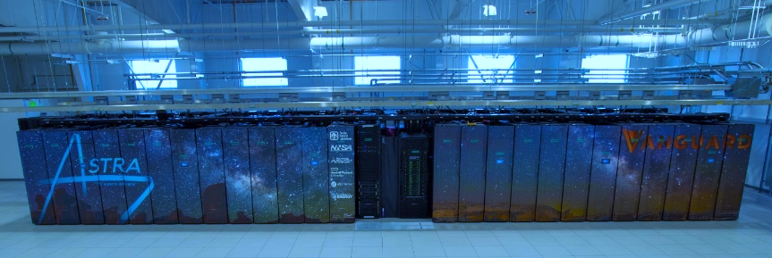
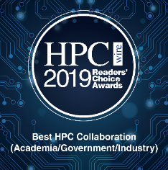
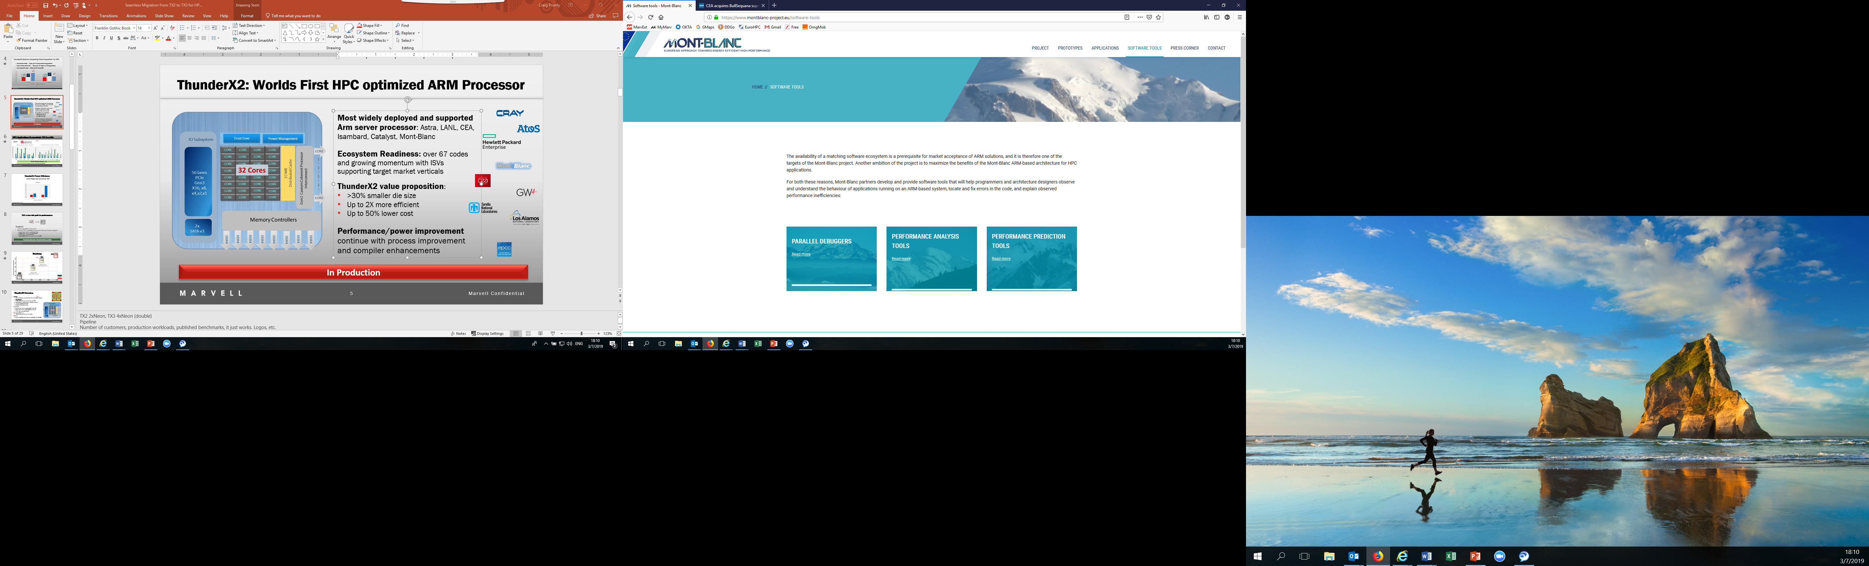













Marvell Arm based Processors
1. Marvell:
An infrastructure company
2. Deployments:
, most widely deployed Arm Server Processor
Catalyst UK
3. Ecosystem:
Has reached the tipping point and is growing organically.
“Porting is easy”. Time is spent on optimization
Questa Advanced Simulator
Notes:
Marvell: investment in servers processors
TX2 is second generation of Marvell Arm Server Processors
Astra top 500. (new numbers) Catalyst HPC wire award GW4 Isambard, CEA … Hackathons, working with industry, running production codes Microsoft announcements (first non-X86 deployment in Microsoft)
Containers: Docker. Singularity on Astra
ISV announcements: Mentor Questa. Altair Radioss™ (POC)
Questions:
What is panel view on HPC in the cloud?
Arm offers choice. How do you make tradeoffs on optimization?
What are the challenges you see for Arm to take the lead in HPC?

